Slide 1
The National Lottery Advert
By Alexis, Izzy and Luke

Slide 2
Planning
We watched some national lottery adverts that already exist.
We made mind maps to gather our different ideas.
We discussed in our groups and made a proposal of our final idea.
We looked into ASA Codes in order to create an approved advert.

Slide 3
Proposal
Title: The Golden Ticket
Summary of idea:
      Focuses on a poor man
      He decides to buy five lottery tickets, but four of them don’t work
      He loses hope but the last one works
      He celebrates with a friend
    Location/ Props: Lottery ticket, film at college.
    Target Audience: People over 16 who need money, students in debt.

Slide 4
Summary of Research
In our research, we watched many different national lottery adverts from different periods of time to get an idea of what we could do. We were able to choose the two best ones and analysed them further.

Slide 5
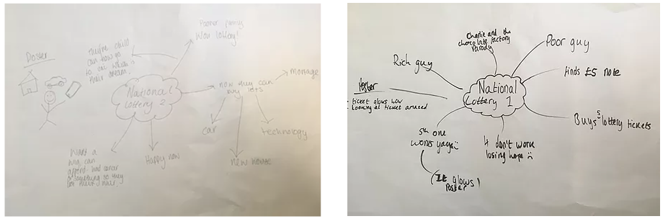
Mindmaps

Slide 6
Rationale
We decided on the Golden Ticket idea because it was light-hearted and relatively amusing.
We did not show that their child could now go to university because it may make the viewers think that their choices are limited in terms of what they could do with the money. With our final idea we were able to showcase many different things a winner could buy.

Slide 7
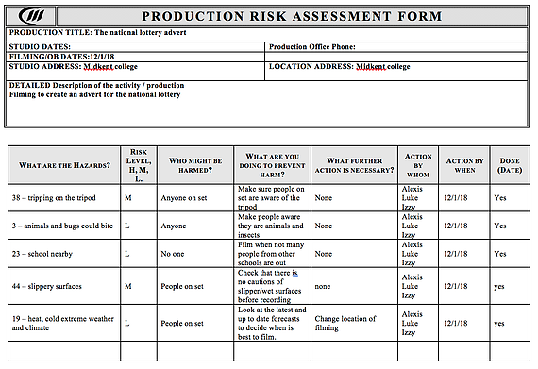
Risk Assessment

Slide 8
ASA Guidelines
In our advertisement we did not show the lottery as gambling or that it lead to any harm. We did not show:
  That it can provide any escape from any problems in real life.
  That it can solve any financial problems or that it can solve depression or any other mental issues.
  That the lottery is a priority in life or show it as peer pressure.
  That it was improving anyone’s self image or self esteem and did not show it as enhancing anyone’s attractiveness.
  That it was being reckless nor that it is a rite of passage.
  That under 18s were being taken advantage or didn’t make it appeal to under 18s.
Our advert did not exploit anyone’s cultural beliefs nor encourage criminal behaviour.

Slide 9

Final Poster

Slide 10
Final Advert
http://www.youtube.com/watch?v=_sGL9xGA7Ik

